Slide 1
CSE 2451 struct union enum
Zichen Zhang

Slide 2
Overview
struct
declaration
members of struct
simple assignment between structs
typedef
Initialization
storage layout
union
syntax
union vs struct
enum
syntax
switch statement use case

Slide 3
Structures(keyword: struct)
Structures are a way to group several related variables into one place.
struct is a type consisting of a sequence of members whose storage is allocated in an ordered sequence (in the program address space)
Like a class in OOP
No methods
No private members
No inheritance
Struct effectively declares a new type of objects
Offer flexibility to represent data with an inherent structure
Serves as a basic building block to derive other data structures:
Linked list
Tree
Graph
And more!

Slide 4
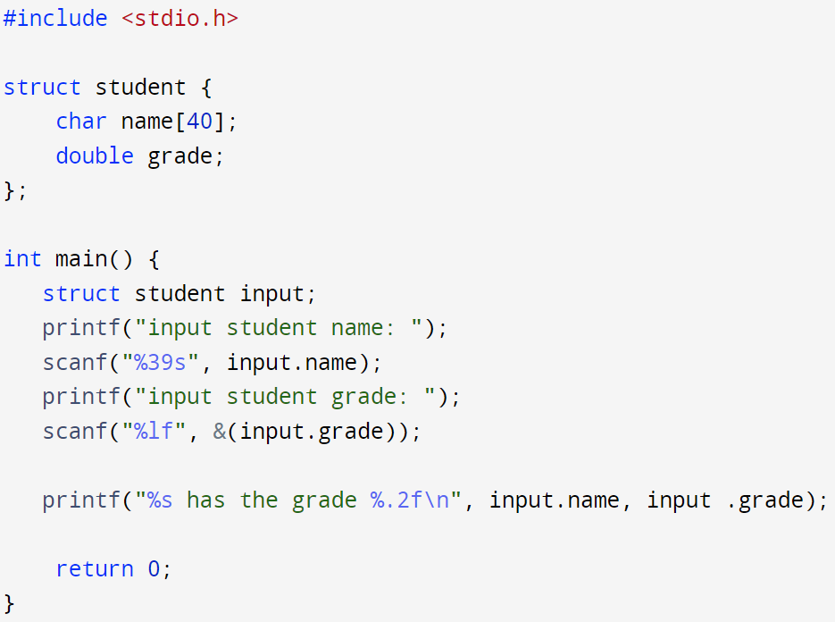
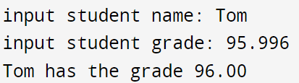
struct – declaration of named struct
struct name {struct-declaration-list}; // named struct
Optional name for this the struct, known as tag
List of members defined for this struct
Use the struct tag to declare the associated object named as input
Access member of a struct with “ . ” dot operator for both read and write

Slide 5
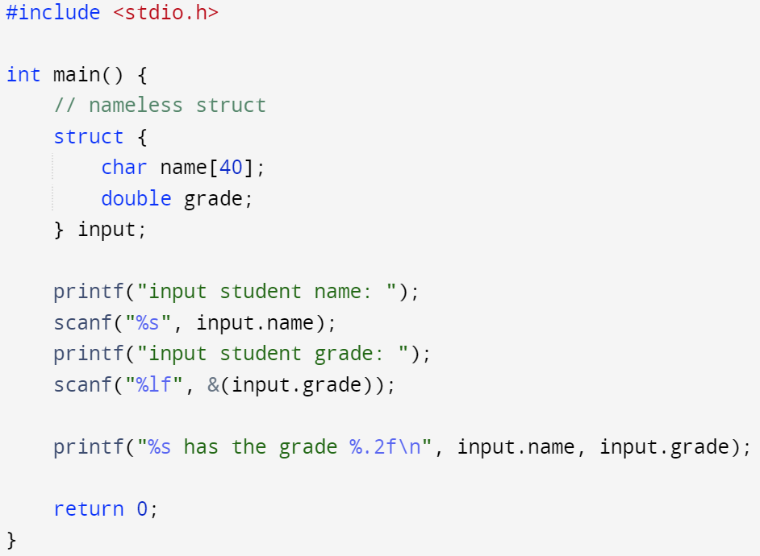
struct – declaration of nameless struct
struct name {struct-declaration-list} object-list; // nameless struct
Declare a struct object, i.e., input using nameless struct
Each time you want to declare such a struct object, you need to repeat the whole struct-declaration-list. Since this struct is nameless, you have no tag to refer it directly as if it is a known type

Slide 6
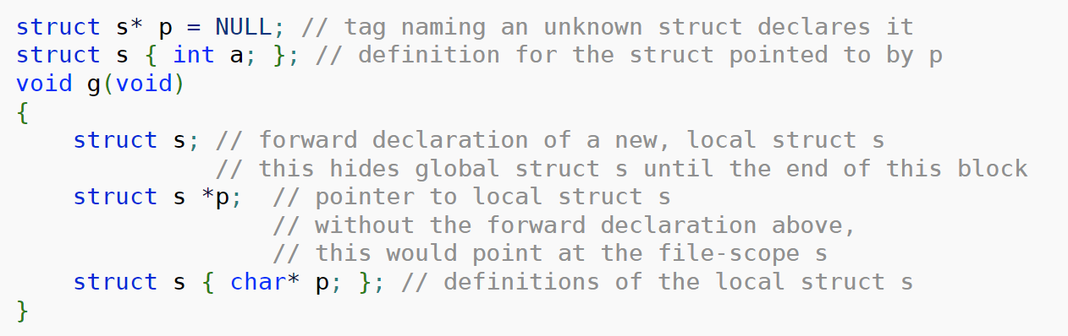
struct – forward declaration
struct name; // declare that a struct with name as its tag exists
This is forward declaration: a type of struct exists, its definition is not known yet
This hides any previously declared tag name in the tag name space for current scope
The actual struct-declaration-list (its members) will be defined later in the current scope
This functions in a similarly way compared to “function prototype vs function definition”
File scope s
block scope s
Notes:
Label name space
Tag names
Member names
Ordinary names: function names, object names, typedef names, enumeration constant names

Slide 7
struct – members
struct is a type consisting of a sequence of members whose storage is allocated in an ordered sequence
Members of the struct is defined in its struct-declaration-list
Members of struct can be:
Numeric data types (char, int, float, double)
Pointers (could be a pointer to object of its own struct type)
struct (nested struct, but not its own type)
An array of constant known size (e.g., int arr[10])
A flexible array (incomplete array type, must be at the end of member list)

Slide 8
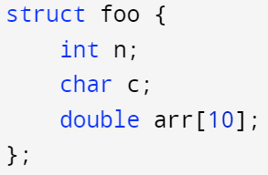
struct – members
A struct with int, char, and array object as its members
Declaration of each member ends with a semicolon ;
Don’t forget the semicolon in the end of the struct declaration

Slide 9
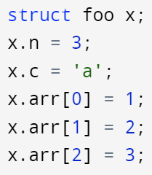
struct – members
A struct with int, char, and array object as its members
Don’t forget the semicolon in the end of the struct declaration
Declaration of each member ends with a semicolon ;
Assign value to struct members via the dot “ . ” operator followed by member’s identifier

Slide 10
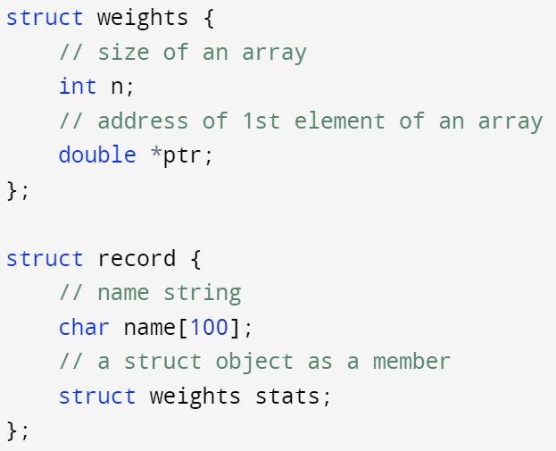
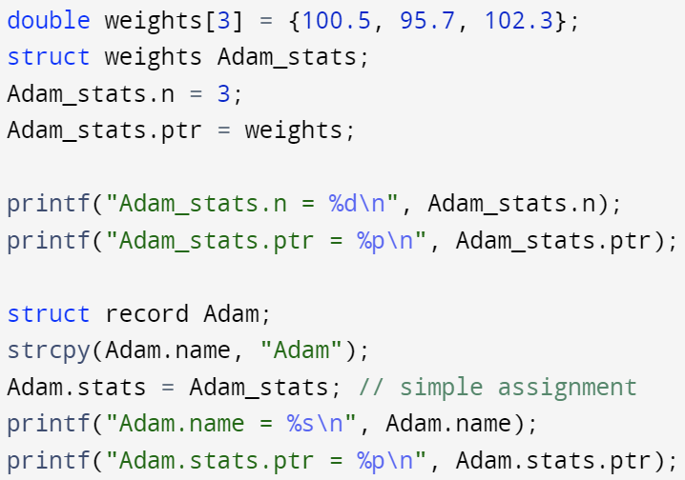
struct – members
A struct can have other struct object as its members
A struct can NOT have a member of its own type (Because members of incomplete type are not allowed, and a struct type is not complete until the end of the definition, a struct cannot have a member of its own type.)
A struct can NOT have another struct as its member, if the other struct has a flexible array member

Slide 11
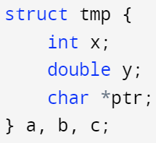
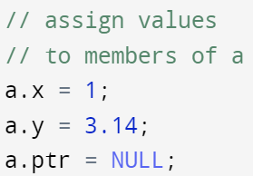
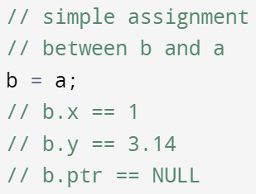
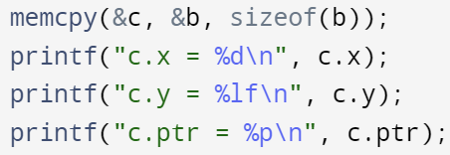
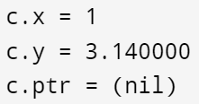
struct – simple assignment
Simple assignment operator is allowed between objects of the same struct type
This can be thought as memcpy between two objects of the same struct type
Note, this is NOT a deep copy, i.e., two objects’ pointer members will point to the same address
Declare a named struct → tmp, and 3 objects of such struct type → a, b, c
Declare a named struct → tmp, and 2 objects of such struct type → a and b

Slide 12
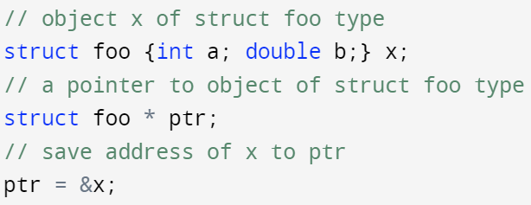
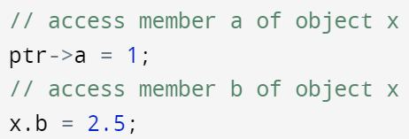
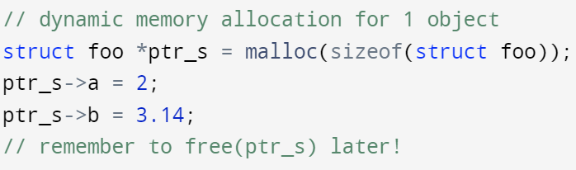
struct – pointer to struct and dynamic memory allocation
A pointer to struct: access struct object’s member via pointer-to operator (“ -> ”)
Dynamic memory allocation for struct type with no flexible array member

Slide 13
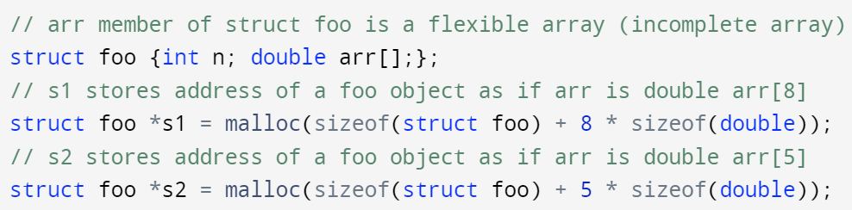
struct – flexible array member
A struct with flexible array member:
can NOT be element of an array
can NOT be a member of other structs
If a struct defines at least one named member, it is allowed to additionally declare its last member with incomplete array type (flexible array)
When an element of the flexible array is accessed, then the struct behaves as if the array member had the longest size fitting in the memory allocated for this object (memory of such a struct can be dynamically allocated)
If no additional storage was allocated, the flexible array behaves as if an array with 1 element, except that the behavior is undefined if that element is accessed
sizeof operator ignores the flexible array member (e.g, sizeof(struct foo) = sizeof(int) = 4 bytes)
Flexible array as last member
The extra number of bytes are assigned to fit the flexible array with longest possible size
sizeof ignores flexible array, and return the size of the struct type as if flexible array doesn’t exist

Slide 14
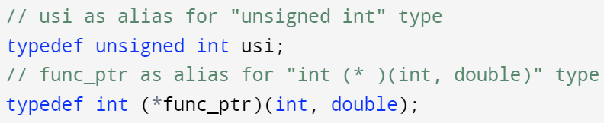
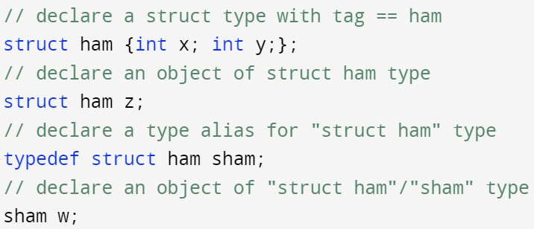
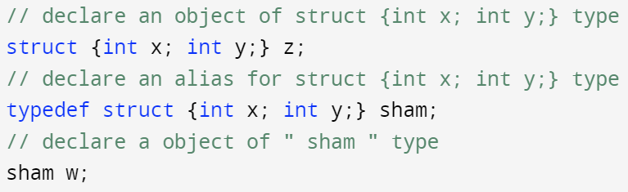
struct - typedef
Recall we can define an alias for existing types with typedef
We can use typedef to simplify the declaration of struct objects
normal case:
type keyword + variable name
special case:
type keyword wraps around variable name
Using typedef on nameless struct directly

Slide 15



struct – initialization
Using standard initializer: values inside {} follow the same order of members defined in the struct
Using designated initializer: using .member_name to specifier which member to initialize (since C99)
All members that are not initialized explicitly are set to zeros
Int: 0, float/double: 0.0, char: ‘\0’, pointer: NULL
array members: set to all zeros

Slide 16
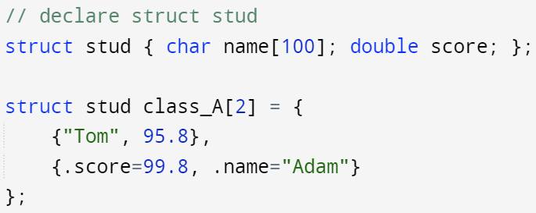
struct – example – array of structs
Array is a type consisting of a contiguously allocated non-empty sequence of objects with a specific element type (this can be struct)
Array of struct objects: array initialization rules still apply in here
Nested initializers

Slide 17
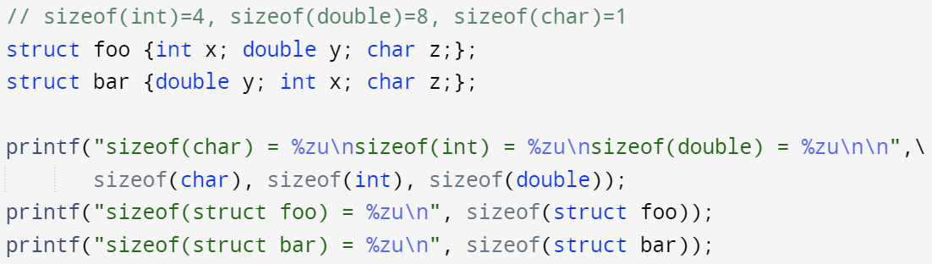
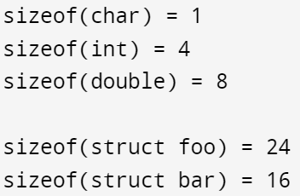

Struct – storage layout of its members
the address of a struct object is the address of its first member
A pointer to struct object can be cast to a pointer to its first member and vice versa
The address of members of a struct object increases in the order of declaration of these members in the struct type’s definition
The size of a struct object $≥$ the sum of sizes of its members
There are 0 paddings in between certain members due to the size of the member

Slide 18
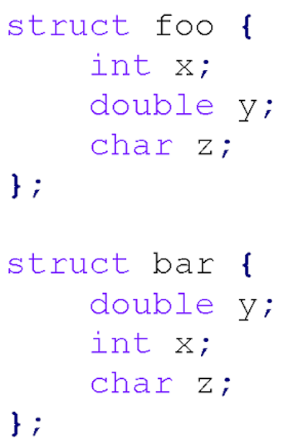
struct – storage layout of its members
Self-alignment of struct
1-byte char members start on any byte address
2-byte shorts must start on an even address
4-byte ints of floats must start on an address divisible by 4
8-byte doubles must start on an address divisible by 8, etc
Aligning members like this makes access faster
For programmers: put larger members before smaller ones in struct-declaration-list
See “The Lost Art of C Structure Packing” by E. S. Raymond for more details
int x
padding
double y
char z
padding
24 bytes
int x
padding
double y
char z
16 bytes

Slide 19
union
A union is a type consisting of a sequence of members whose storage overlaps (as opposed to struct, which is a type consisting of a sequence of members whose storage is allocated in an ordered sequence)
A union may have many members, but only one member can contain a value at any given time (all members share the same piece of memory)
A union object is only as big as necessary to hold its largest member
A union provide efficient way of using the same memory location for multiple purposes

Slide 20
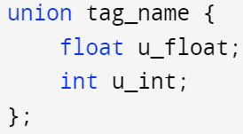
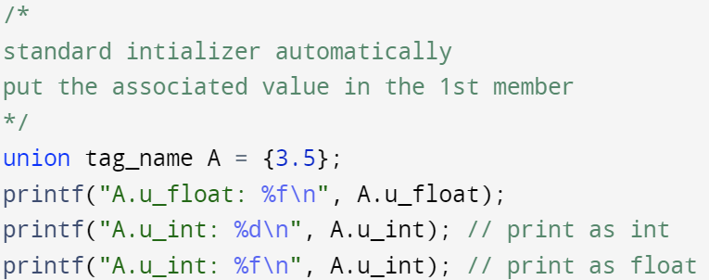
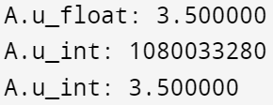
union – syntax
Type keyword: union
The rest of union’s syntax follows the same rules as the syntax of struct with the following exceptions:
Only one member can hold a value at any given time (it’s the programmer's responsibility to keep track of which member that holds the data)
Flexible array is NOT allowed to be a union member
A pointer to union can be cast to a pointer to each of its member’s type, as they all share the same starting address

Slide 21
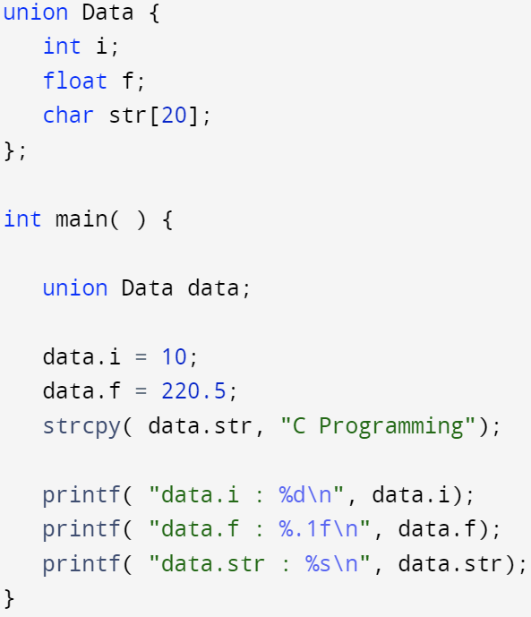
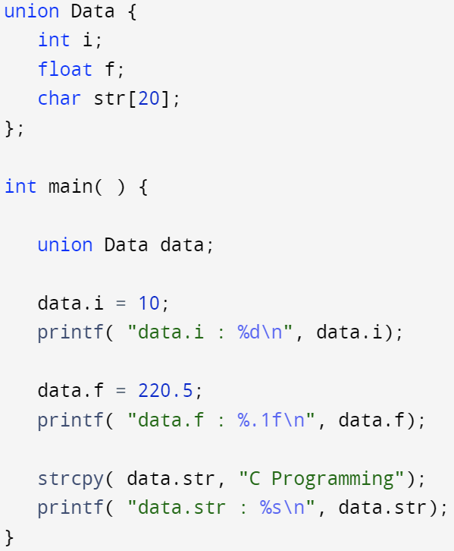
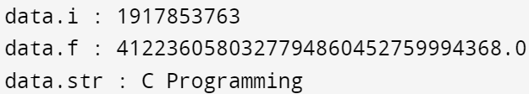
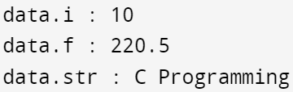
union – example
Overwriting value in the shared memory location
Access (use) the member before overwriting its value
Corrupted data for member i and f
correct data for member i and f

Slide 22
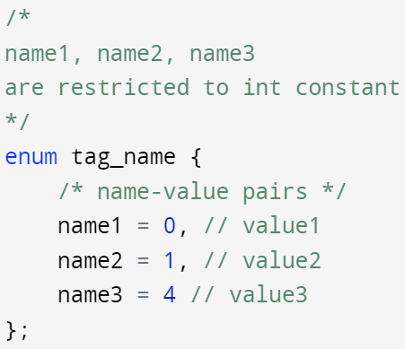
Enumeration (enum) - syntax
enum tag_name {enumerator-list};
Has an optional tag name like struct/union
Is a user defined data type. It is mainly used to assign names to integral constants, the names make a program easy to read and maintain.
Name: identifier of the enumerator
Value: restricted to integer constant (optional)
“enum tag_name” as a whole effectively forms a type keyword similar to “struct tag_name”:
struct foo A;
enum bar B;

Slide 23


enum – enumerator-list
If we only have names of enumerators, their values start at 0 and increase by 1 from each enumerator
If we explicitly assign values to certain enumerators, the rest of the enumerators has values one greater than their preceding enumerator

Slide 24
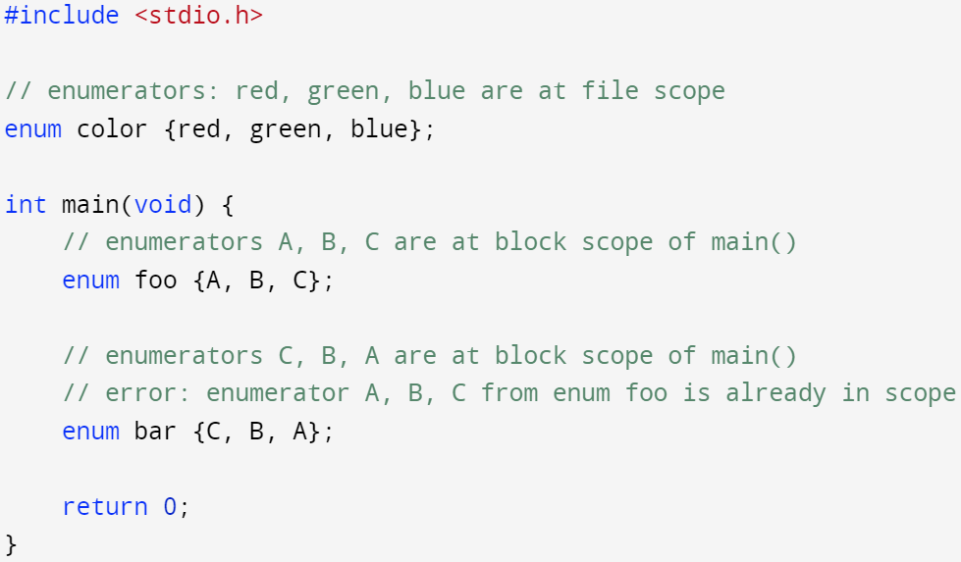
enum - scope
enumerated type follows the standard scoping rules
enumerator of an enumerated type is in the scope enclosing the enumerated type
Error:
name collision

Slide 25
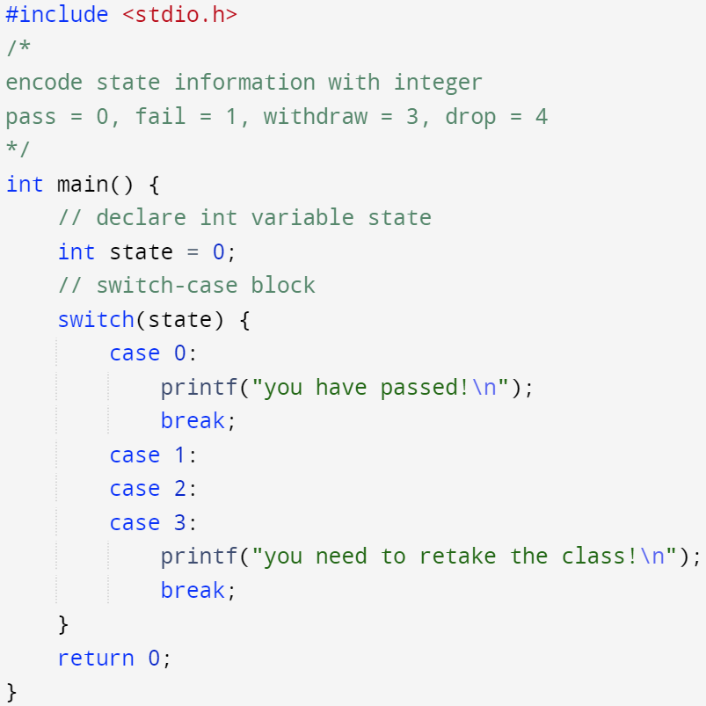
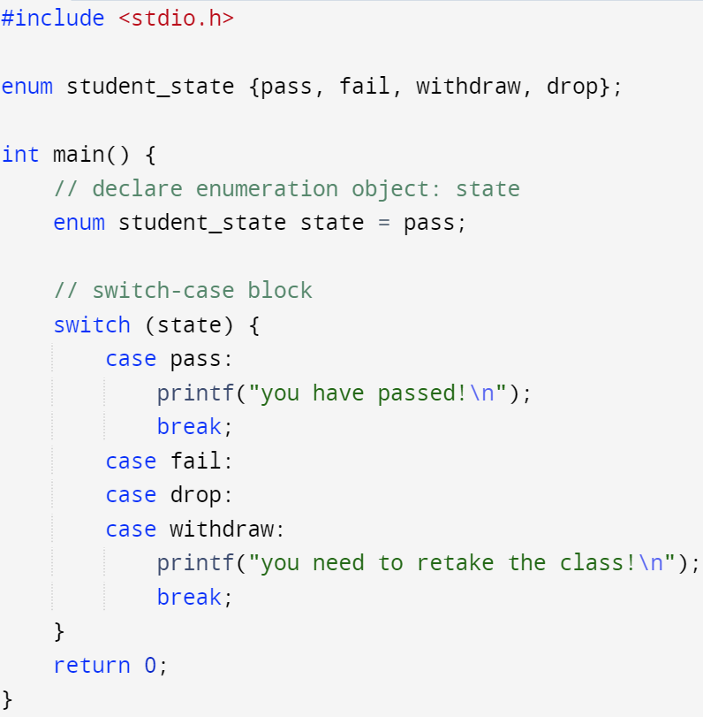
enum – switch-case example
Use enumerated type + switch-statement
Enumerated type object, assign its value with enumerator

Slide 26
enum – switch-case example
Enumerators are named integral constants → they can be used as constant expression (case label) of switch-statement
Increase readability of the switch statement
Ensure type safe flow control
the compiler will check if all enumerators of the enum have been handled by switch statement in case that some cases are missed
Need to compile your code with –Wall option to enable such warning message

Slide 27
enum – switch-case example
If we missed the ‘drop’ case in switch statement
When compiling with –wall option:
waring: enumeration value ‘drop’ not handled in switch [-Wswitch]
switch (state) {

Slide 28
enum
An enumerated type is a distinct type whose value is a value of its underlying type, which includes the values of explicitly named integral constants
The underlying type of the enumerated type is compatible with one of the following (implementation-defined):
char
signed int
unsigned int
Whichever underlying type it is, it must be capable of representing all enumerator values of the enumerated type

